Slide 1
MySQLProject (https://mysqlproject.com/)
Group Members:
1. Raghu Nandan Lal Garikipati - 11754328
2. Lohith Reddy Kallappareddygari - 11803258
3. Bala Nikhil Pasala - 11774086
4. Naveen Kumar Reddy Bhavanam - 11823630

Slide 2
Outline
Introduction
Benefits
Technologies Used
Implementation
Future Work
Conclusion
References

Slide 3
INTODUCTION
MySQL is an online project that teaches structured query language, with an emphasis on problem-solving techniques.
Users can learn while doing chores or studying through the procedures set up.
The goal is individualized instruction that is interactive and dynamic, moving at the learner’s pace.

Slide 4
Benefits
Data can be manipulated and organized to provide insight or power applications.
MySQL is a flexible tool for backend development since it supports a wide range of programming languages, including PHP, Python, Java, and even C++.
MySQL is very often required for database administrator, data analyst, back-end developer, and full-stack developer positions.
Writing complex queries to solve real-life problems while learning MySQL enhances your ability to analyze.

Slide 5

Technologies
Frontend: HTML, CSS, Java script
Backend: phpMyAdmin which accessed from Cpanel, JavaScript
Platform: Laravel
Compiler: Jdoodle API For SQL Compiler
Multifactor Authentication: Email Otp based
Payment: Stripe API
Database: MySQL database.

Slide 6
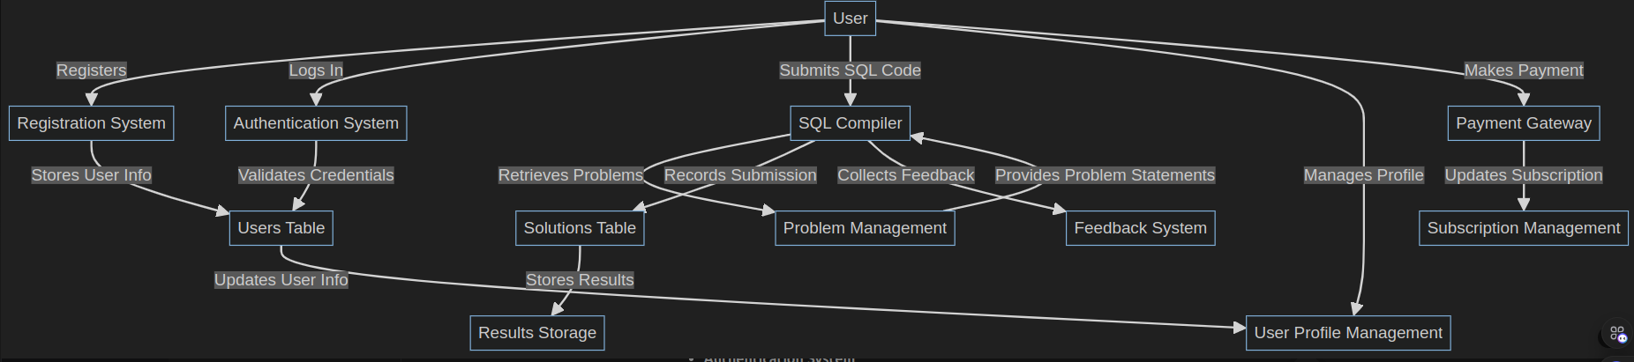
Data Flow Diagram

Slide 7
Registration Page
Key user information, including first name, email address, and password, is gathered by a secure registration system.
Multi-factor authentication increases security by requiring an email-based OTP verification.
MFA for registration and log in
Secure registration page for user.

Slide 8
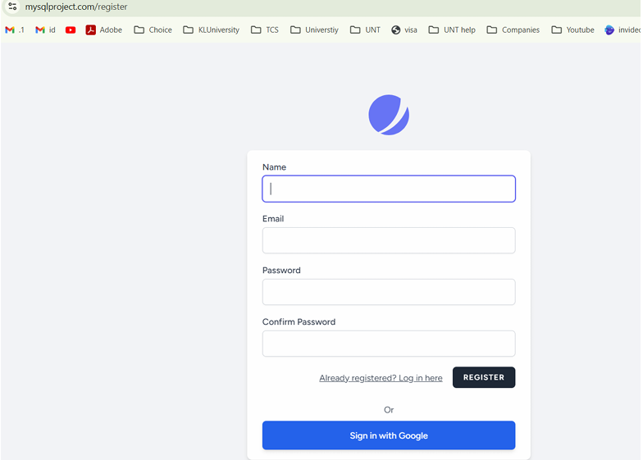
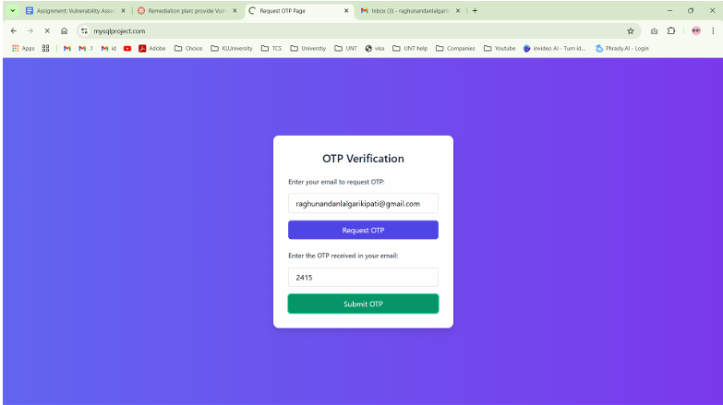

Slide 9
Login and Dashboard
Page with suggested challenges and a summary of the courses the user has enrolled in.
An easy-to-use interface for problem-solving, login is part of the design.
Easy access on all devices is ensured with responsive design and clear navigation.

Slide 10
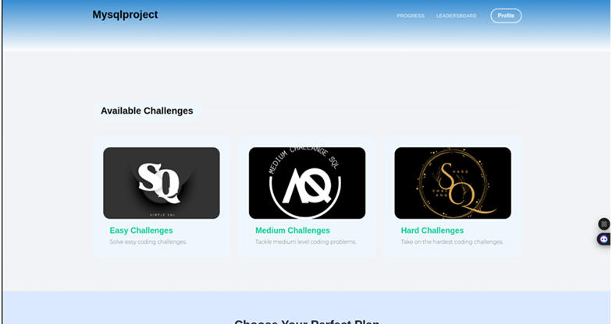
Login and Dashboard

Slide 11
Problem Practice Page
User can select easy, medium, hard issues based on their level of difficulty
The problem statement is displayed on the left side of a dual-plane arrangement.
For smooth query execution, a SQL compiler is available In the right plane.

Slide 12
Subscription Management:
Premium subscriptions are enabled using a payment gateway.
Monthly and annual plans are available to users.
Stripe is used to conduct secure payments.

Slide 13
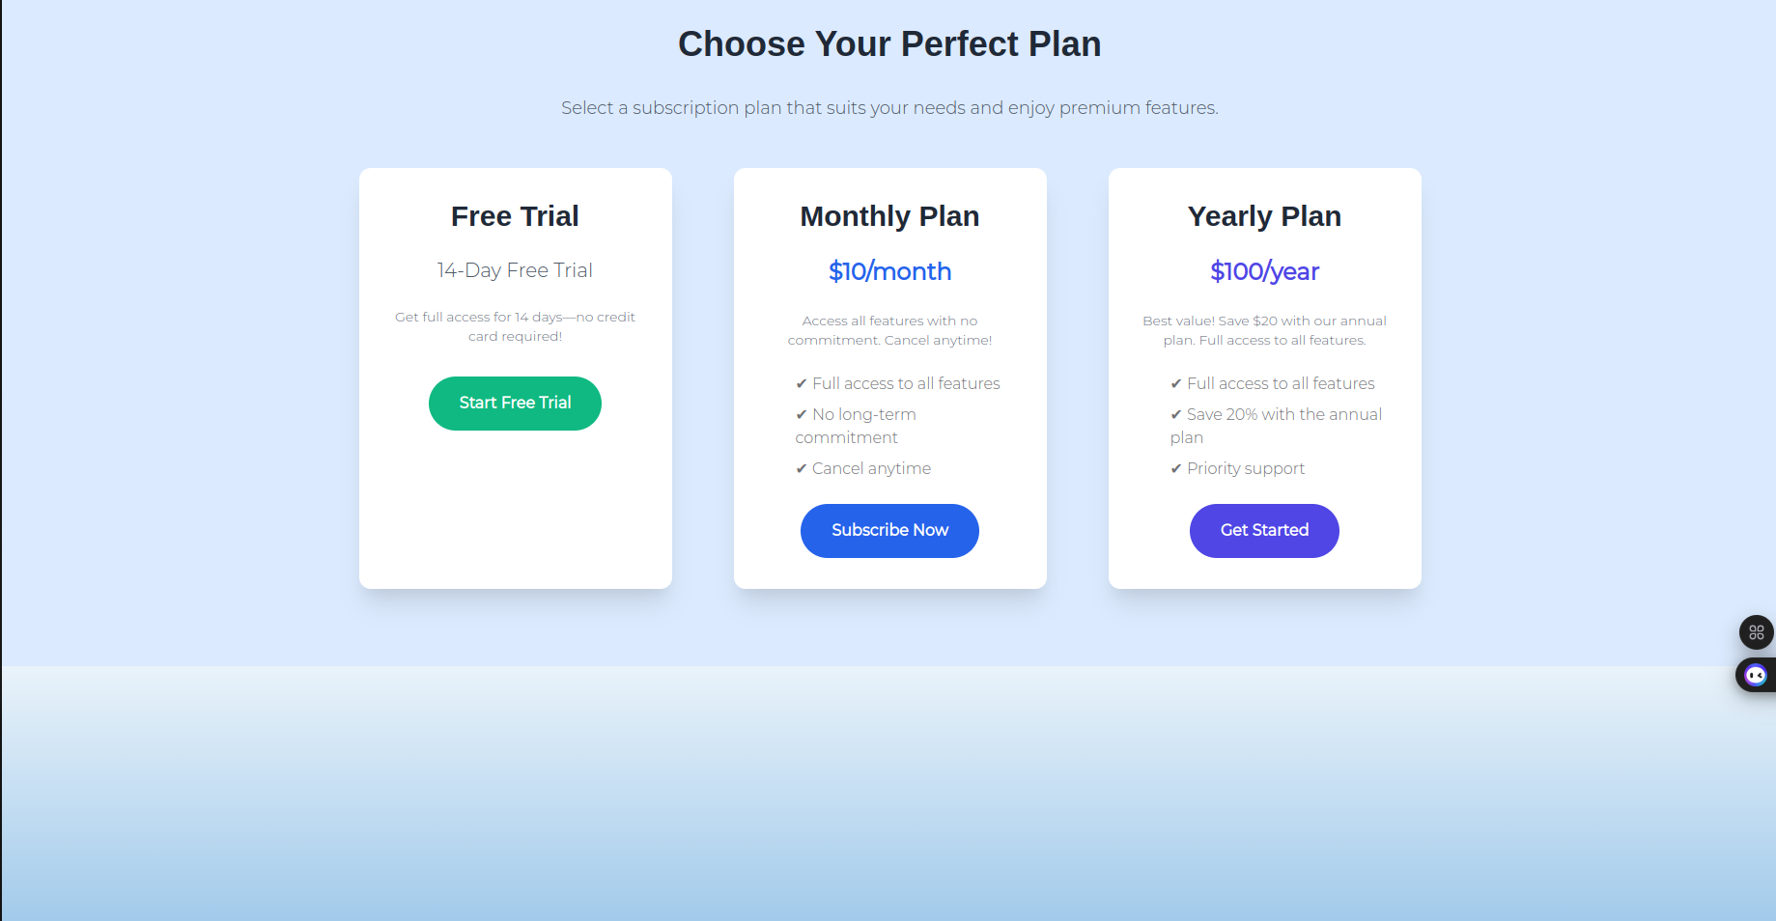
Subscription Management:

Slide 14
Real Time Feedback:
Instant feedback on SQL submission is provided to users.
Only user-created tables are according to the system.
By looking at their tables, users can track their progress.

Slide 15
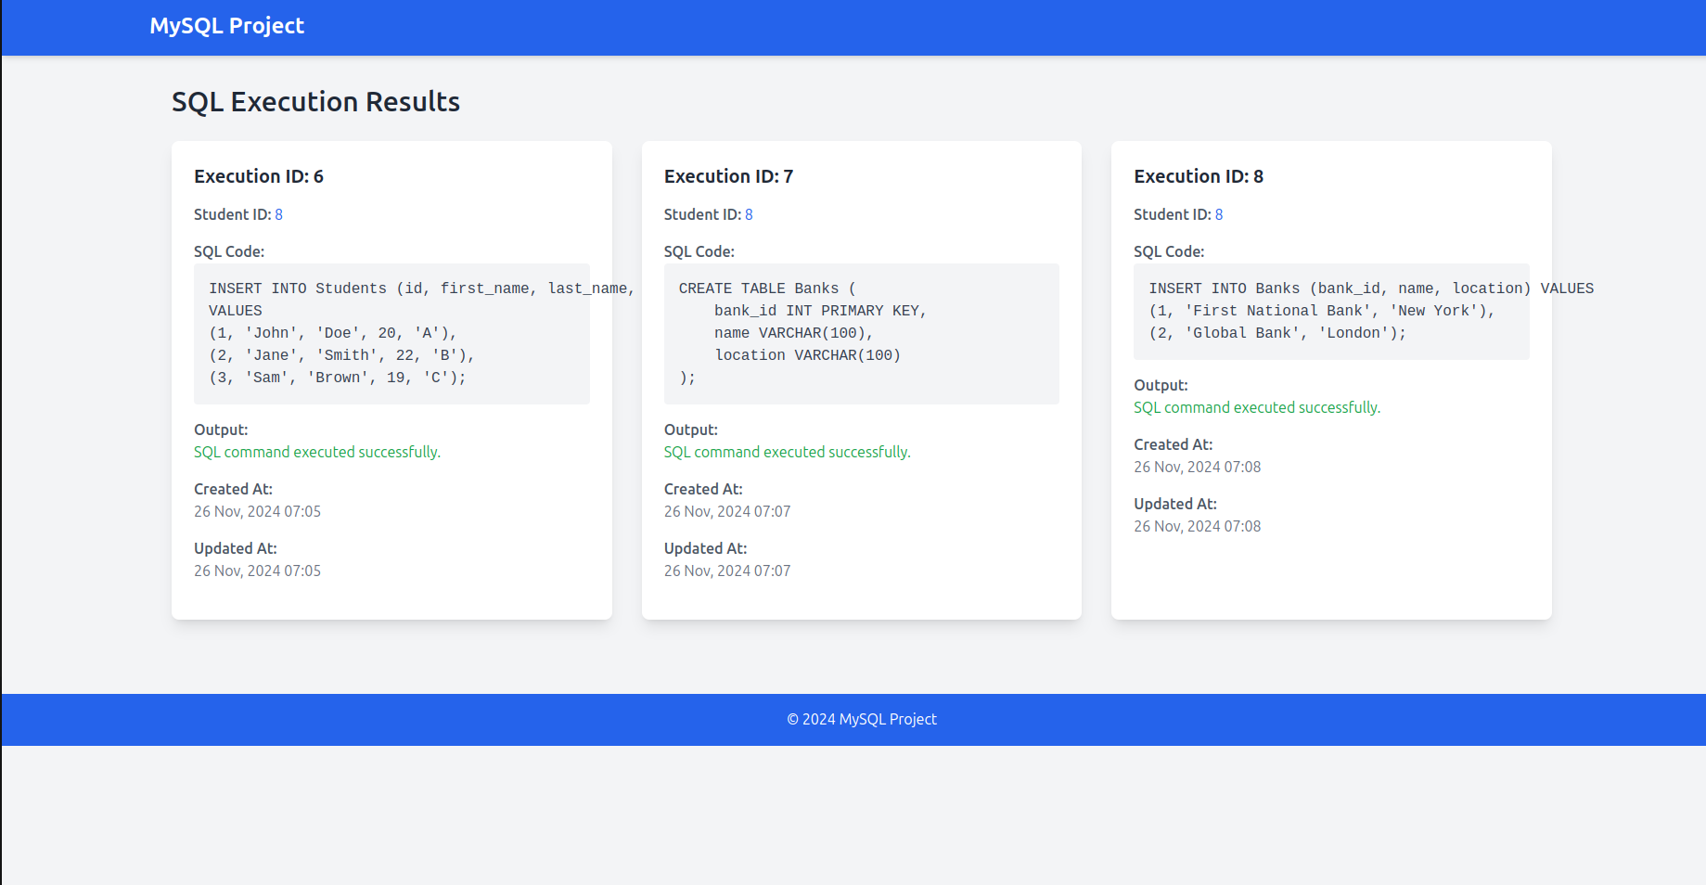
Real Time Feedback:

Slide 16
User Profile Management:
Users can view their subscription status and update their personal information.
Effective session management is ensured via secure logout and active session tracking.
The program offers a platform that is both safe and easy to use.
It safe-guards user data while improving SQL learning.

Slide 17

Future work
Analysis to monitor each completed task’s progress.
Add the social sign-in option like github.
Create collaborative, shared user forums.
Explain the course topics in detail like AI/ML.

Slide 18

Outcome
Implemented a Secure system with multifactor authentication
Implemented PaymentGateway
Integrated real time sql compiler
User focus: makes progress, engagement, and tracking easier.

Slide 19
Conclusion
Learn by doing: to help students grasp Query language course with questions.
Future ready: adding more complex subjects and teamwork resources.
Detailed instructions: a learning aid for SQL.
User focus: makes progress, engagement, and tracking easier.

Slide 20
References
Mysql query understanding (https://www.exoscale.com/syslog/explaining-mysql-queries/#:~:text=In%20MySQL%2C%20EXPLAIN%20can%20be,as%20a%20service'%20OR%20foo
Laravel platform development (https://laravel.com/docs/11.x/starter-kits)
Stripe documentation( https://stripe.com/docs/api)
Laravel stripe integration(https://laravel.com/docs/11.x/billing)

Slide 21

Thank You

